Slide 1
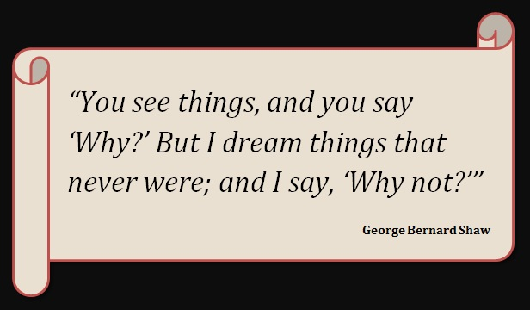
Medico Legal Documents & Category of Hurt

Slide 2
Medico Legal Documents & Category of Hurt
HURT
Whoever causes bodily pain, disease or infirmity to any person is said to cause hurt
There are four categories of hurt based on the MLEF

Slide 3
Categories of Hurt
Non- grievous injury
Grievous injury
Endangering Life
Fatal in the ordinary cause of nature

Slide 4
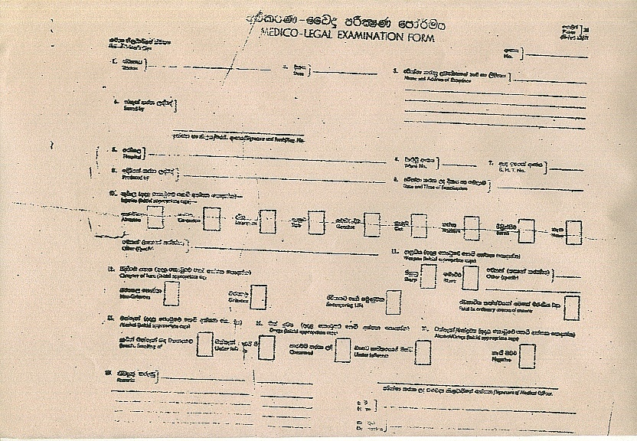
Medico Legal Examination Form(MLEF)

Slide 5
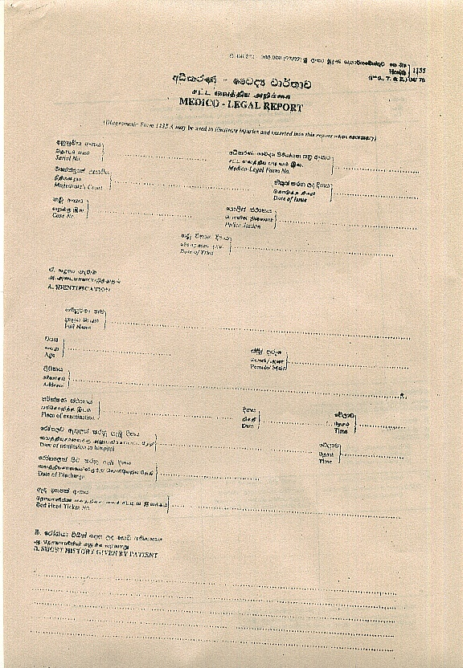
Medico Legal Report- Page 1

Slide 6
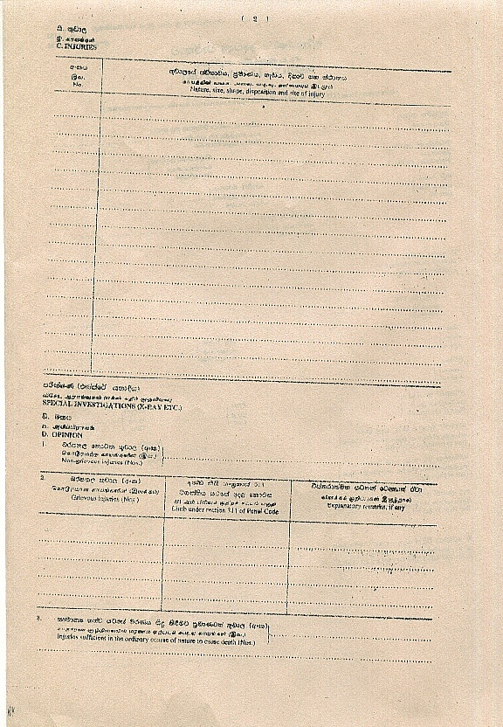
Medico Legal Report- Page 2

Slide 7
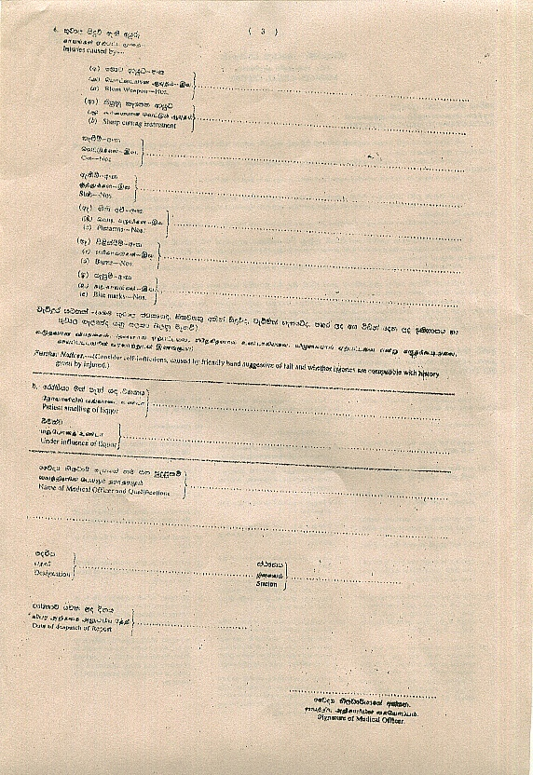
Medico Legal report- Page 3

Slide 8
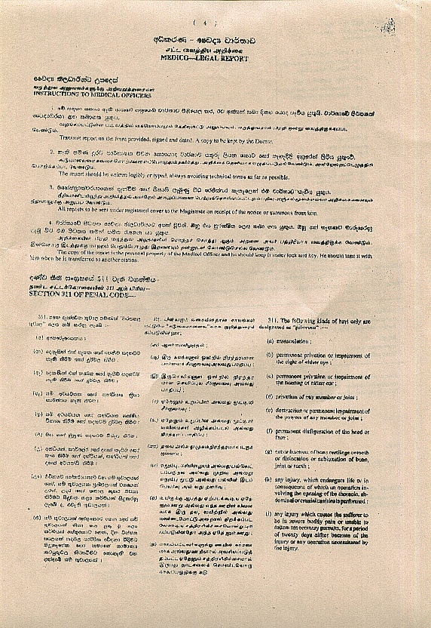
Medico Legal report- Page 4

Slide 9
Non- grievous injury
An injury which does not fall within the purview of section 311 of chapter 16 of the penal code is considered as a non grievous injury

Slide 10
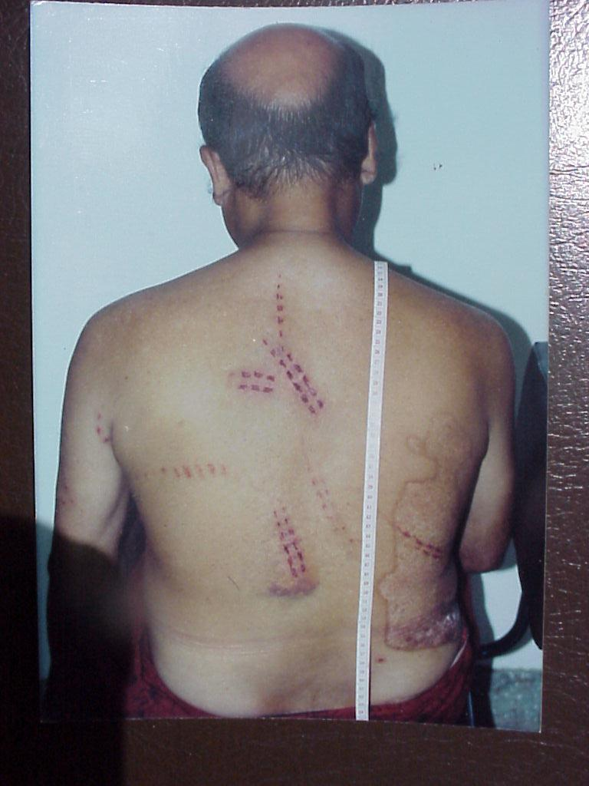
Imprint abrasions

Slide 11
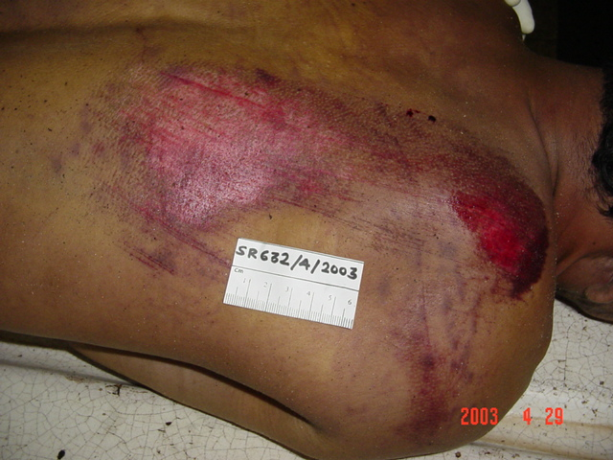
Grazed abrasion

Slide 12
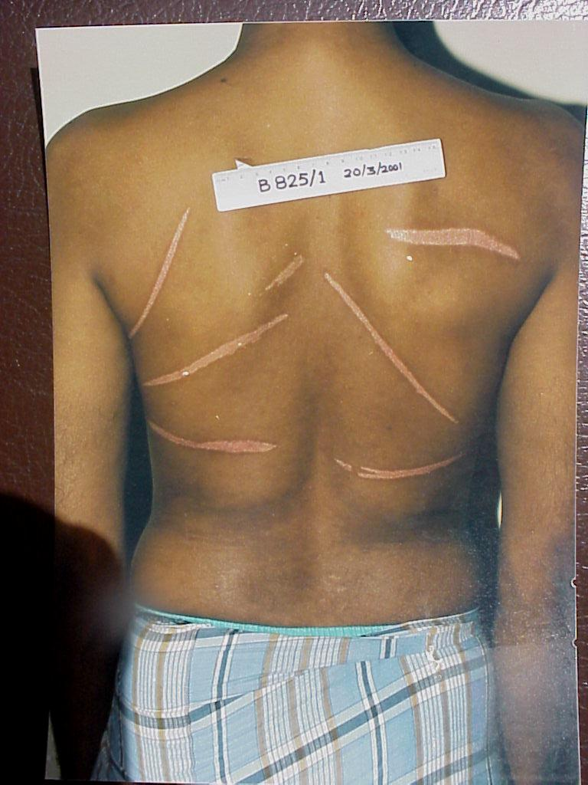
Scars

Slide 13
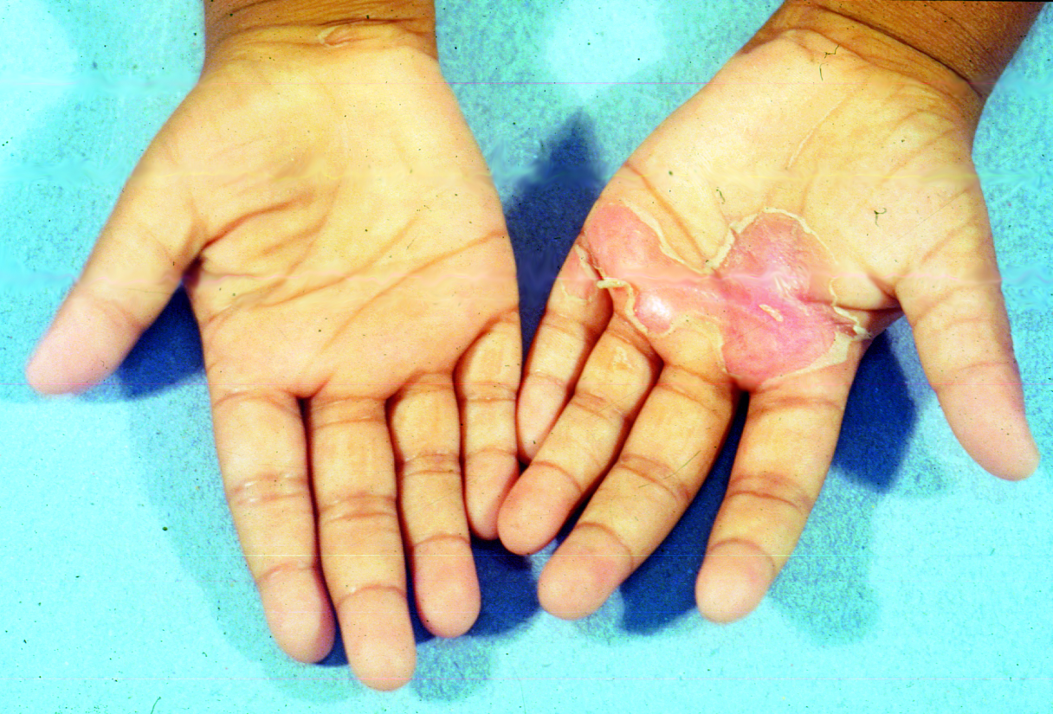

Slide 14
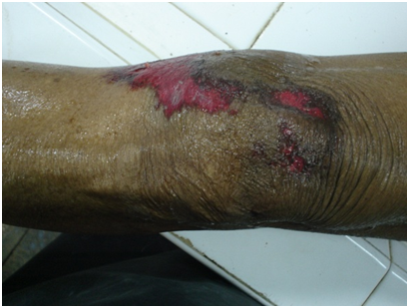

Slide 15
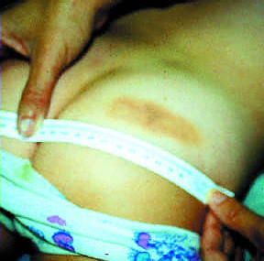
This contusion
was caused by a belt.

Slide 16
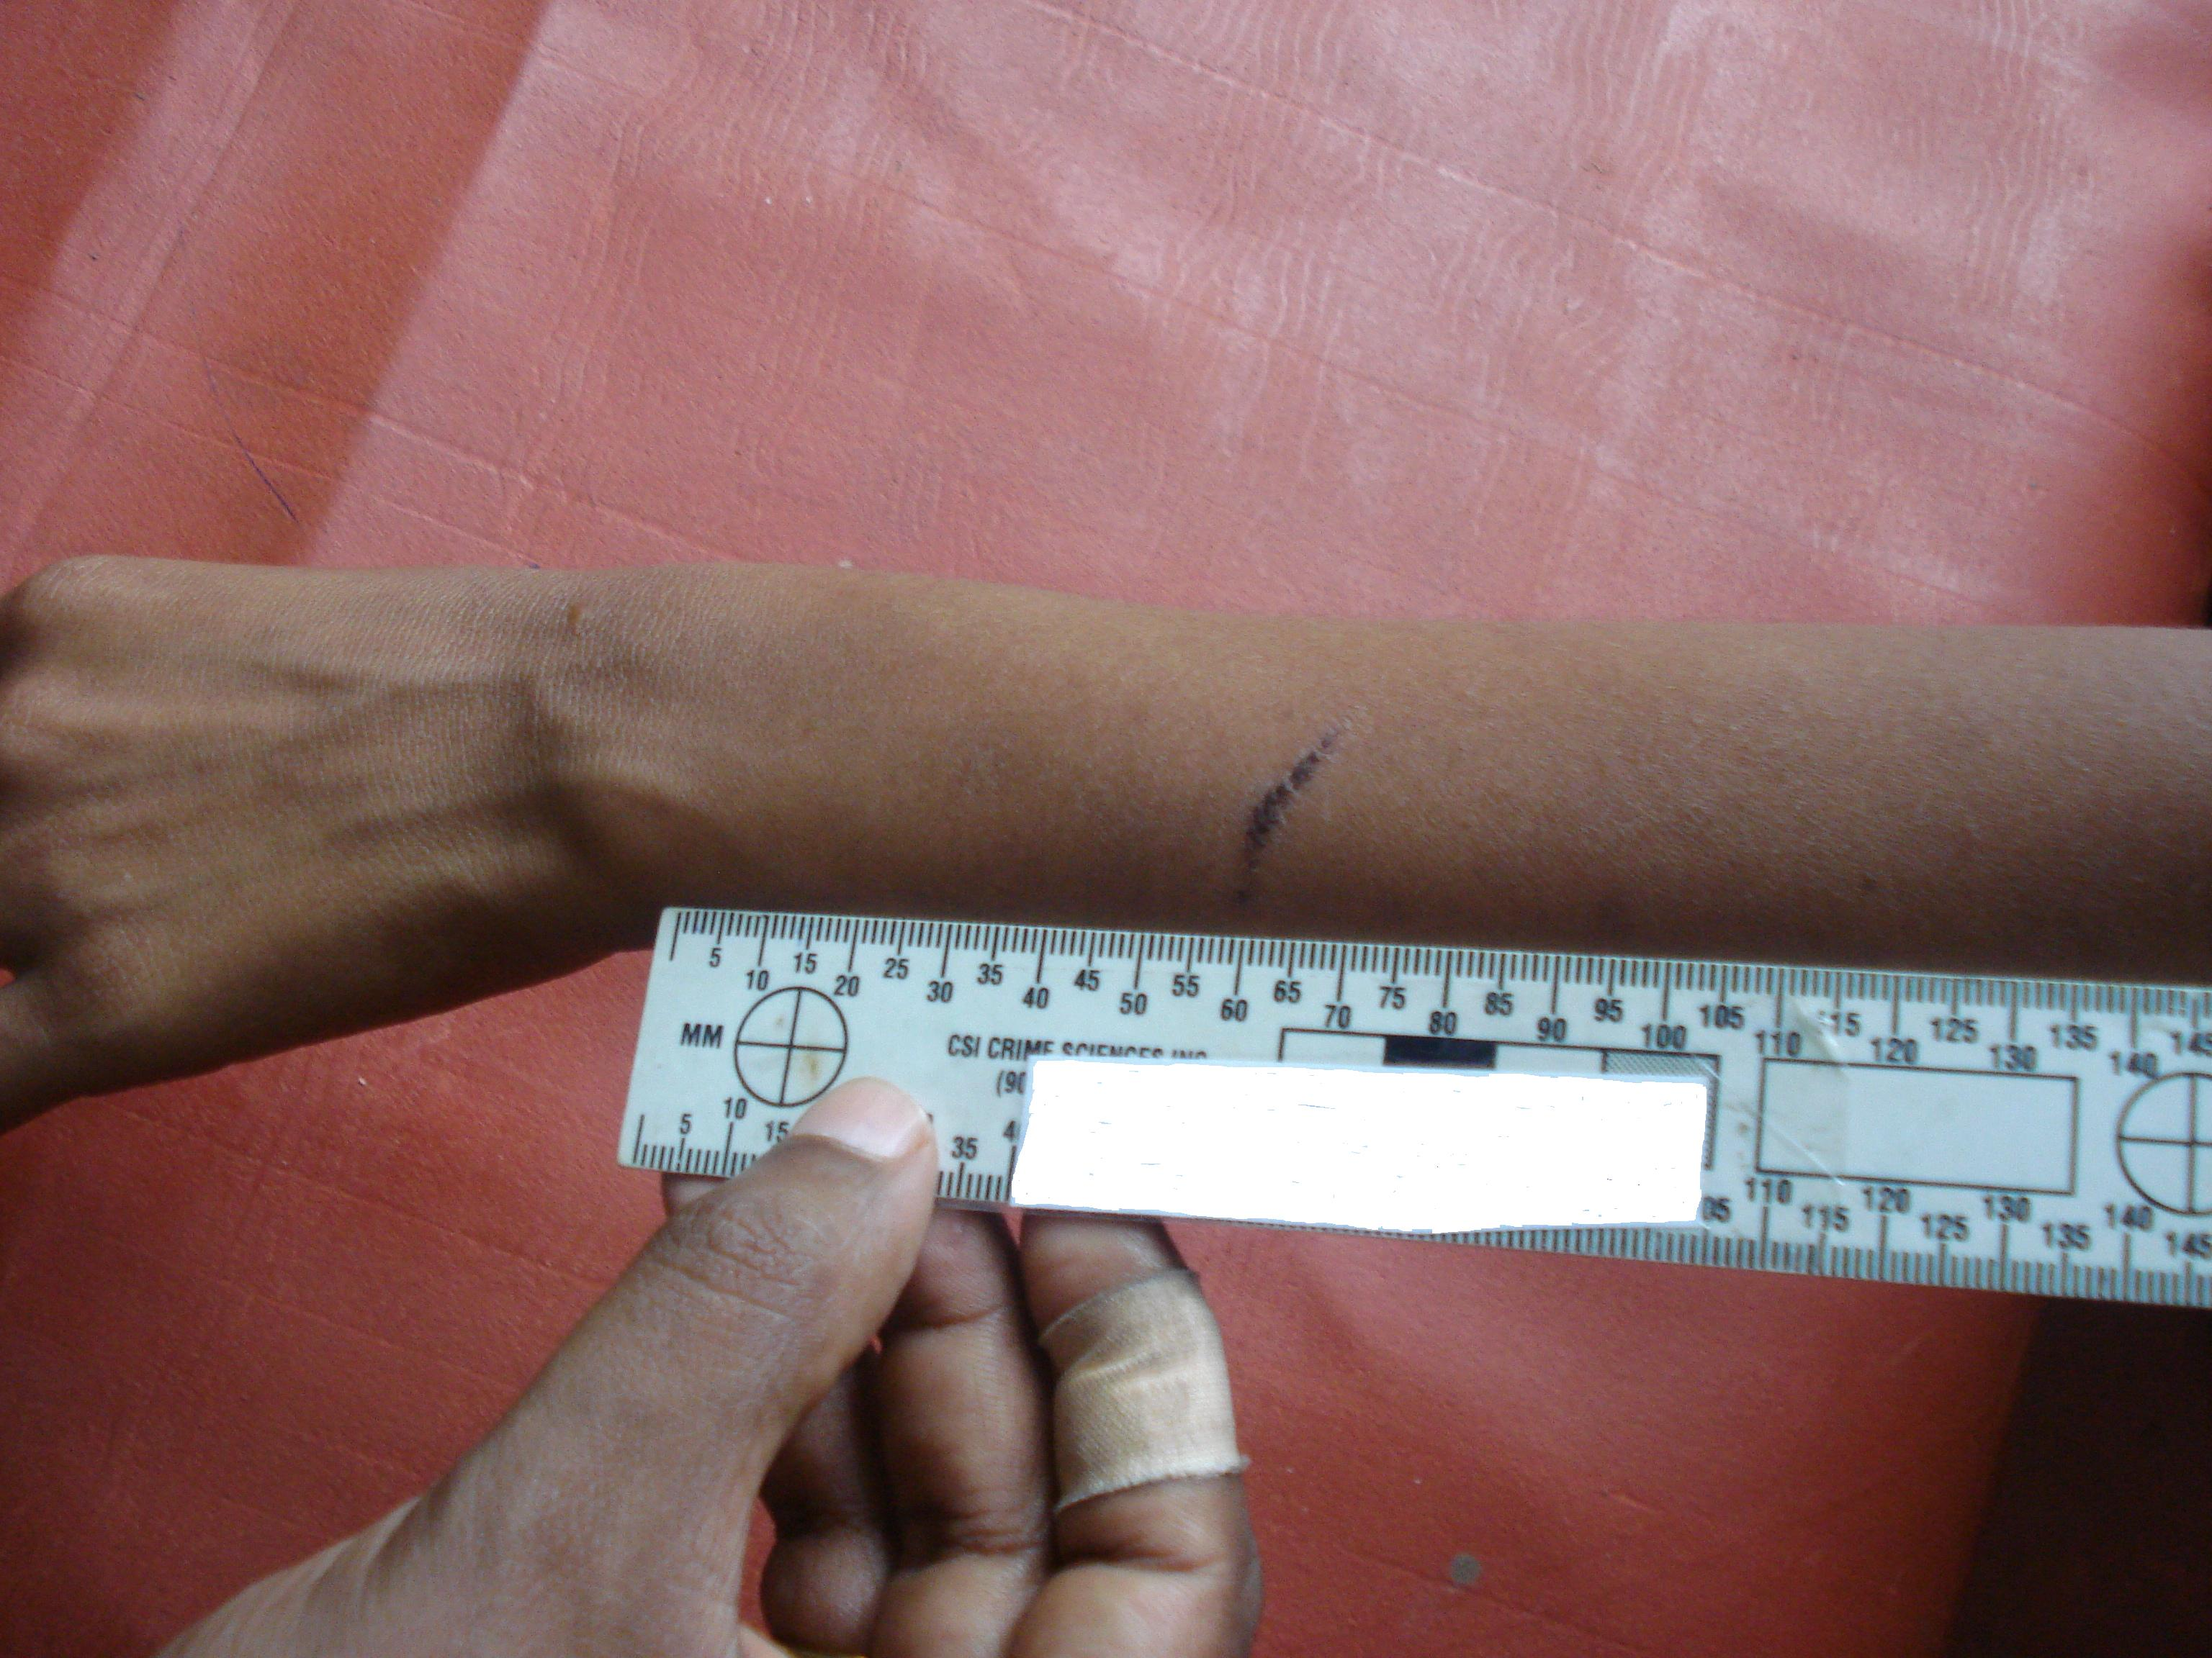

Slide 17
Grievous injuries
All injuries that constitute an offence of causing grievous hurt are embodied in section 311 of chapter 16 of the penal code
Limb (a)- Emasculation( Make a man unmanly)
Anatomical- Cutting off genitals
Physiological- make him sterile/Impotent

Slide 18
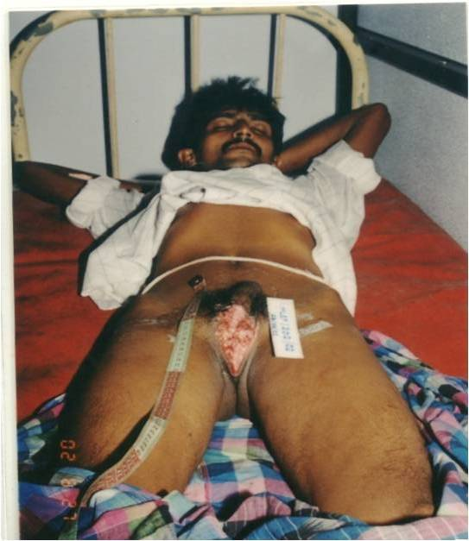
Emasculation

Slide 19
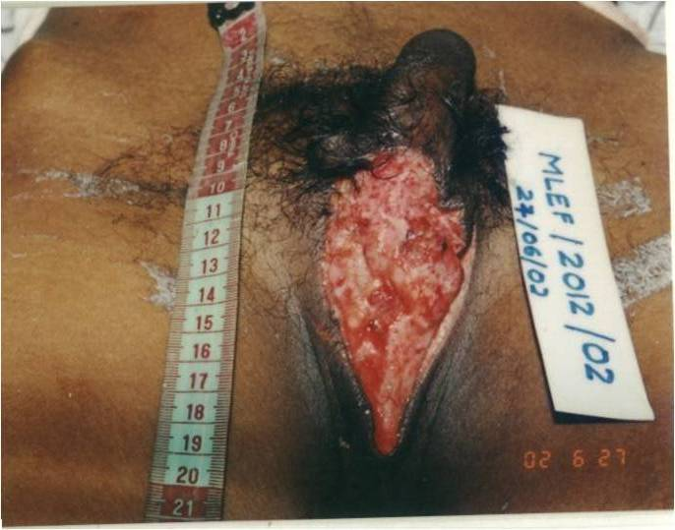
Emasculation

Slide 20
Limb (b)
Permanent privation or impairment of the sight of either eye
It may be total loss of vision of either eye
OR
Permanent impairment of vision of either eye

Slide 21
Limb (C)
Permanent privation or impairment of the hearing of either ear
It may be total loss of hearing of either ear
OR
Permanent impairment of hearing of either ear

Slide 22
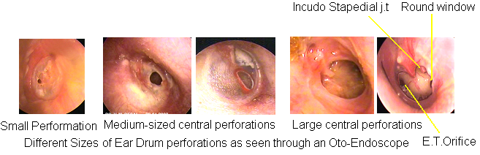
Perforated tympanic membrane

Slide 23
Limb (d)
Privation of any member or joint
Privation of a member- eye,ear,nose,tongue
Privation of a joint

Slide 24
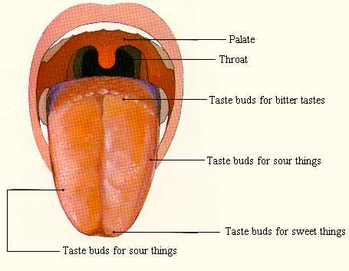
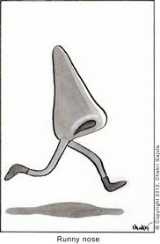


Slide 25
Limb (e)
Destruction or permanent impairment of the powers of any member or joint
Destruction of the powers of a member
Destruction of a joint
Permanent impairment of powers of a member
Permanent impairment of powers of a joint

Slide 26
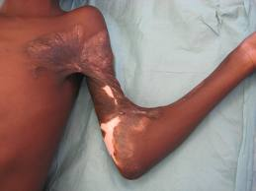

Slide 27
Limb (f)
Permanent disfiguration of head or face

Slide 28
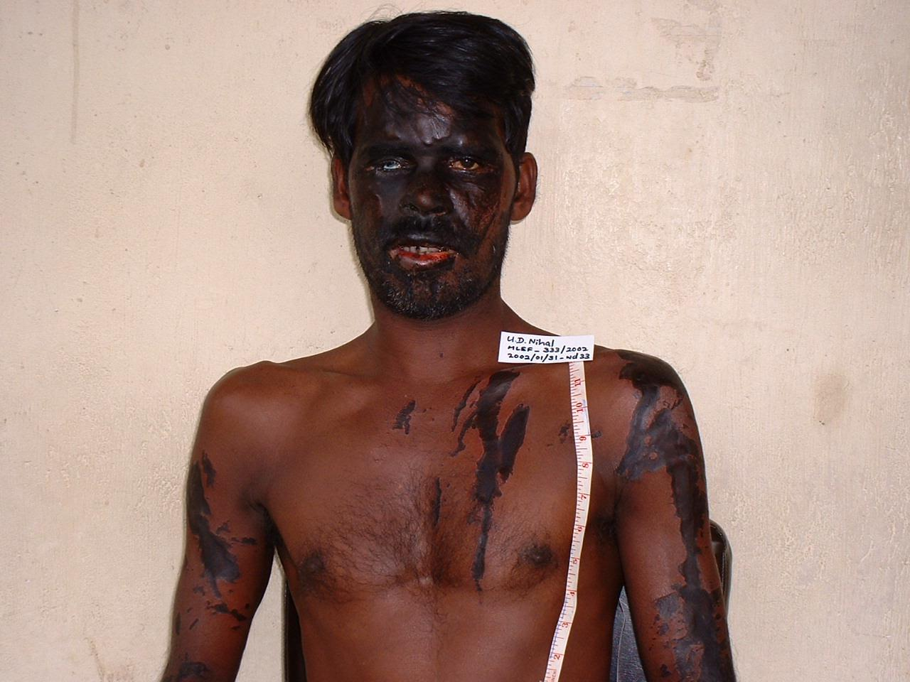
Limb (f)
Permanent disfiguration of head or face

Slide 29
Limb (g)
Cut or fracture of bone, cartilage or tooth or dislocation or subluxation of bone, joint or tooth
Cut or Fracture of bone or cartilage
Dislocation or subluxation of bone or joint
Cut or fracture of tooth
Dislocation or subluxation of tooth

Slide 30
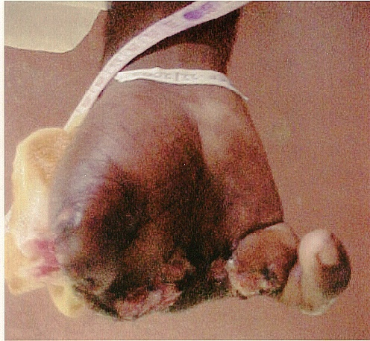
Traumatic amputation of fingers

Slide 31
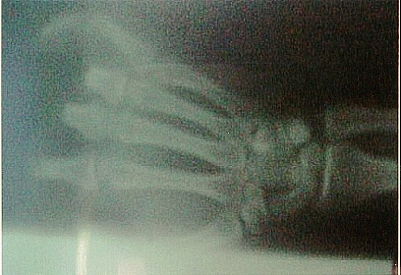
X-ray Findings of slide 25

Slide 32
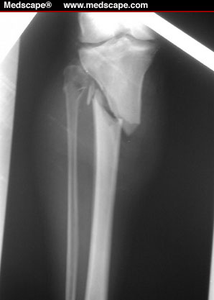

Slide 33
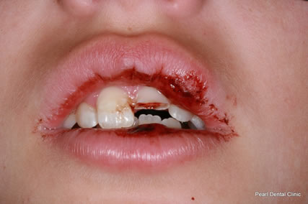

Slide 34
Limb (h)
Any injury which endangers life or in consequence of which an operation involving the opening of the thoracic, abdominal or cranial cavity is performed
An injury is said to endanger life, when there is an existing threat to life by way of
Shock
Haemorrhage
Damage to vital organs
Complication already arisen

Slide 35
Limb (i)
The sufferer to be in severe bodily pain or unable to follow ordinary pursuits for a period of 20 days

Slide 36
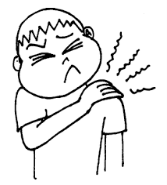

Slide 37
Fatal in the Ordinary Cause of Nature(FOCN)
It is an injury that would definitely result in death in the absence of prompt and proper medical care
E.g. Large Extra Dural haemorrhage
Haemopericardium with cardiac tamponade
Rapidly expanding pneumothorax

Slide 38
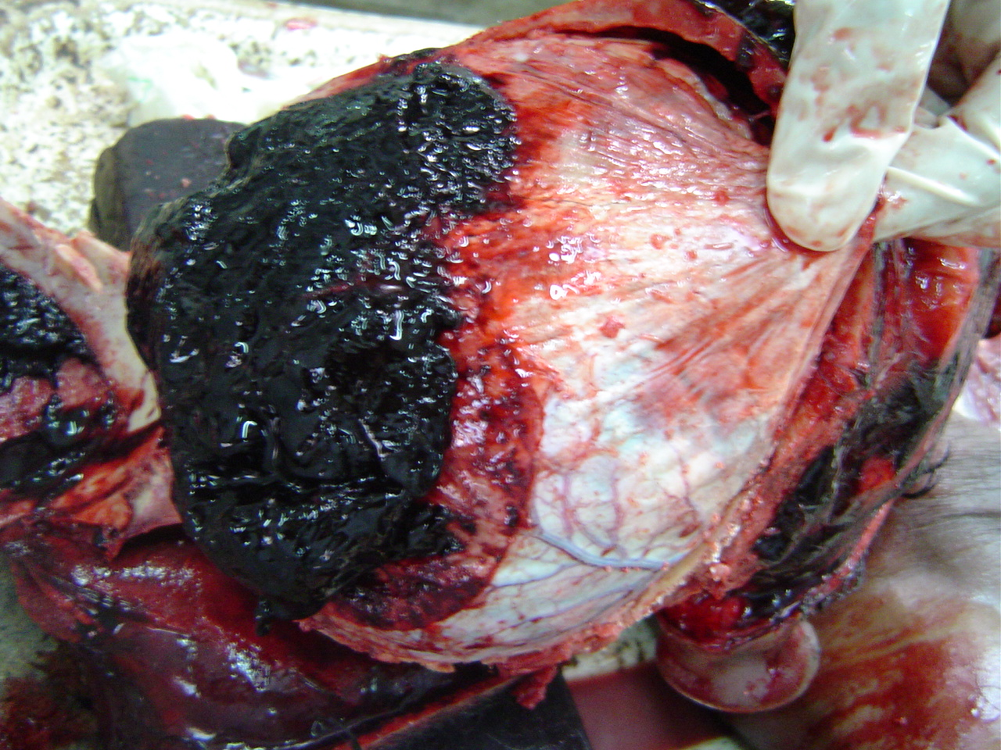
Large Extra dural haemorrhage

Slide 39
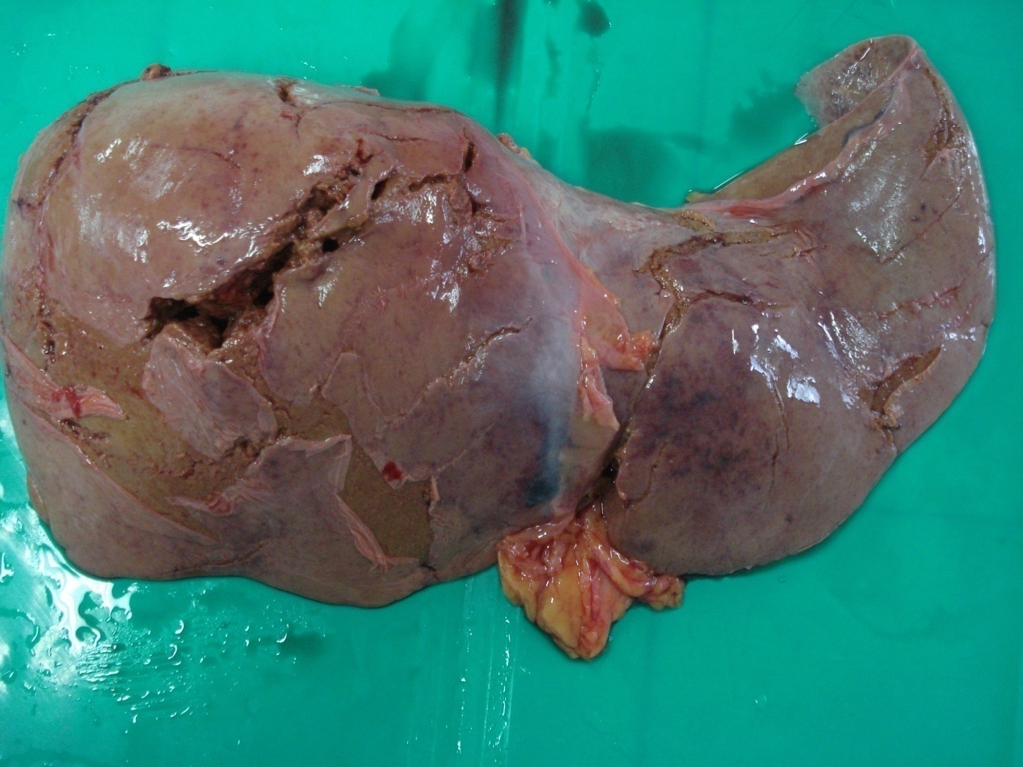
Multiple lacerations

Slide 40
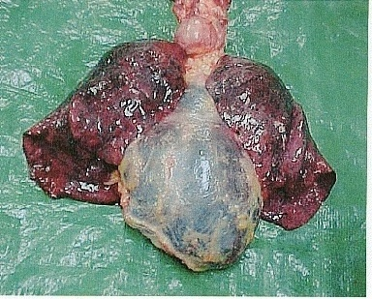
Haemopericardium

Slide 41
Necessarily Fatal
No amount of medical attention can save the life of the person. Since the person is dead it does not come under causation of hurt.
E.g. Decapitation
Severed brain stem
Complete rupture of aorta

Slide 42
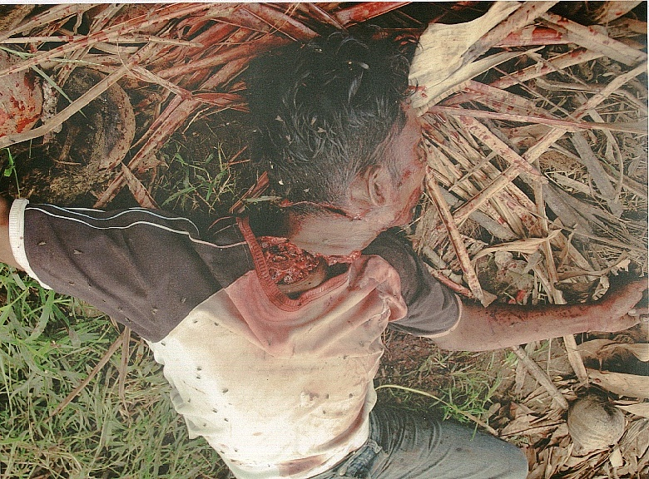
A body with decapitation

Slide 43
Reference
1. Lecture Notes in Forensic Medicine Volume I by Dr L.B.L.de alwis
First Edition
2. Knight’s Forensic Pathology
By Bernard Knight
Third Edition

Slide 44
Thank You

